Slide 1

Netaji Subhas University Of Technology(East Campus)
(Formerly Ambedkar Institute Of Advanced Communication Technologies & Research)
AI based Voice Assistant
BTP Project (2020 – 2024)
April, 2024
Presented By:
Ashish Raj (2020UCB6032)
Tusshar Kashyap (2020UCB6014)
Aakash Sharma (2020UCB6027)
Under Supervision of:
Dr. Shobha Bhatt

Slide 2
Content
Introduction
Motivation
Literature Survey
Objectives
Problem Statement
Scope and Impact
Methodology
Implementation
Results
Conclusion
Future Scope
References

Slide 3
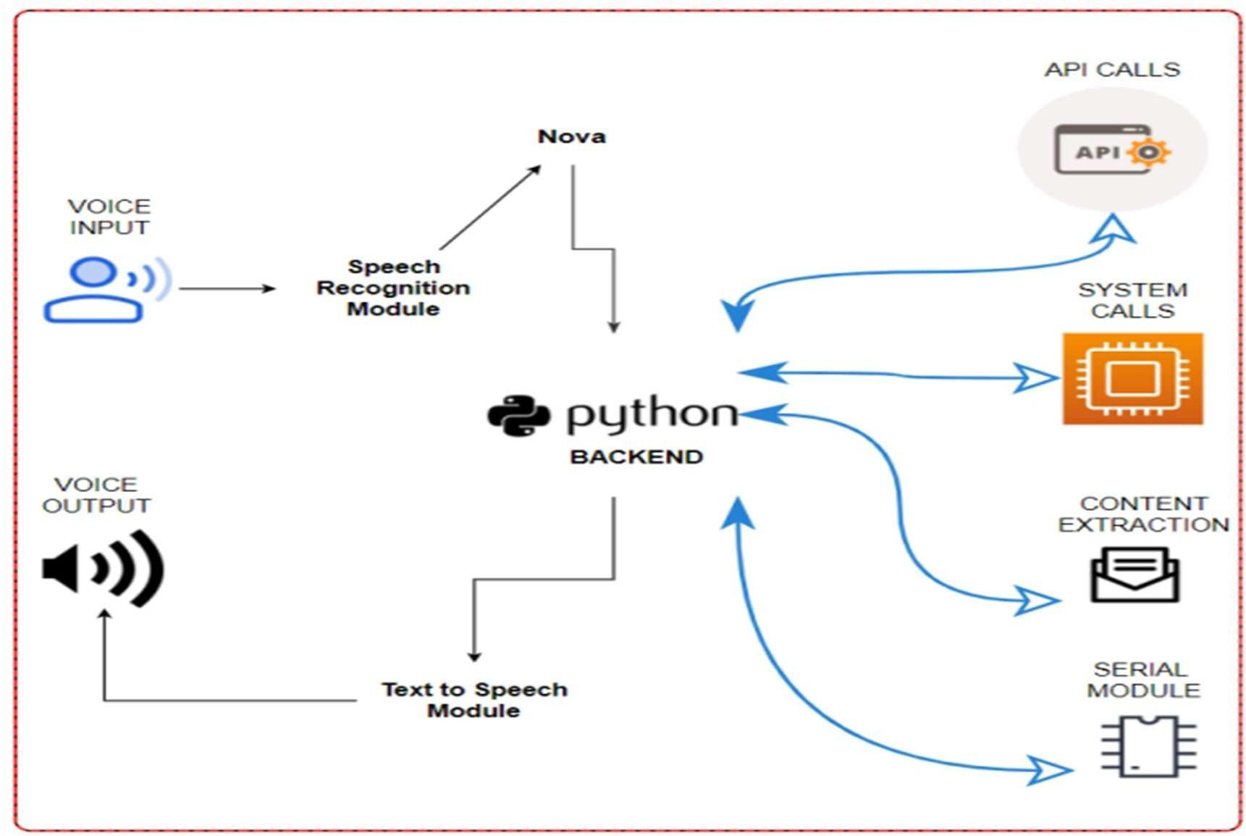
INTRODUCTION
Figure 1 :- System Architecture

Slide 4
INTRODUCTION
Artificial intelligence (AI) has revolutionized the way people obtain information in the rapidly evolving digital world. AI voice assistants is useful instruments that offer variety of services.
As technology improves, users are searching for creative solutions that enhance their experience. By answering user inquiries in a conversational manner, artificial intelligence voice assistants seek to make their interactions with users enjoyable as well as effective.
The creation of a voice assistant with AI that is customized to users' needs. Its features include information providing, random facts, calculator functions, and customized viedo recommendations.

Slide 5
MOTIVATION
Enhancing User Experience: The motivation behind developing an AI voice assistant lies in improving user convenience in today's digital era. By integrating features like information provision, calculator functionalities, and personalized video suggestions, the aim is to streamline user interactions and enhance overall satisfaction.
Efficient Information Retrieval: With the exponential growth of digital data, there's a need for intuitive methods of accessing and processing information.
calculator functionalities: Users often require quick access to basic computational functionalities, with the voice assistant, users can perform calculations seamlessly through voice commands.

Slide 6
Literature Survey
Voice Assistant : An overview of prominent voice assistant technologies such as Siri, Alexa, and Google Assistant, highlighting their applications across various domains.
Natural Language Processing (NLP) and Voice Recognition: It enabling AI voice assistants to accurately interpret and respond to user queries in a conversational manner.
Implementation of Calculator Features: Investigate the implementation of calculator functionalities within AI voice assistants, including supported mathematical operations and considerations for user interface design and integration.

Slide 7
Problem Statement
Information Overload: With the abundance of online information, users struggle to sift through and find relevant data quickly, leading to decreased productivity and frustration.
Improving Calculator Functionality: How can the functionality and usability of the calculator feature within AI voice assistants be improved to support a broader range of mathematical operations and provide intuitive user interfaces.
Personalizing Video Recommendations: What algorithms and approaches can be utilized to enhance the personalization of video recommendations by AI voice assistants, considering user preferences, contextual relevance, and diversity of content.

Slide 8
Objectives
To develop an AI-based voice assistant capable of performing various tasks such as information retrieval, calculations, and entertainment suggestions.
To utilize technologies like natural language processing (NLP) to enable seamless interaction and accurate responses.
To increase efficiency by giving users the ability to complete things hands-free by utilizing voice commands' comfort.
To include customized functionality, meet individual desires, and improve user interaction.

Slide 9
Scope and Impact
Project aims to develop an AI voice assistant with advanced features, including information retrieval, calculator functions and play videos.
The project includes designing intuitive user interfaces and voice commands to ensure ease of use and accessibility for a diverse user base.
By enabling hands-free operation, the voice assistant aims to enhance user productivity and convenience in various contexts.
The project's impact lies in transforming human-computer interaction, enhancing daily life by providing efficient, personalized assistance and inclusivity in digital technology.

Slide 10
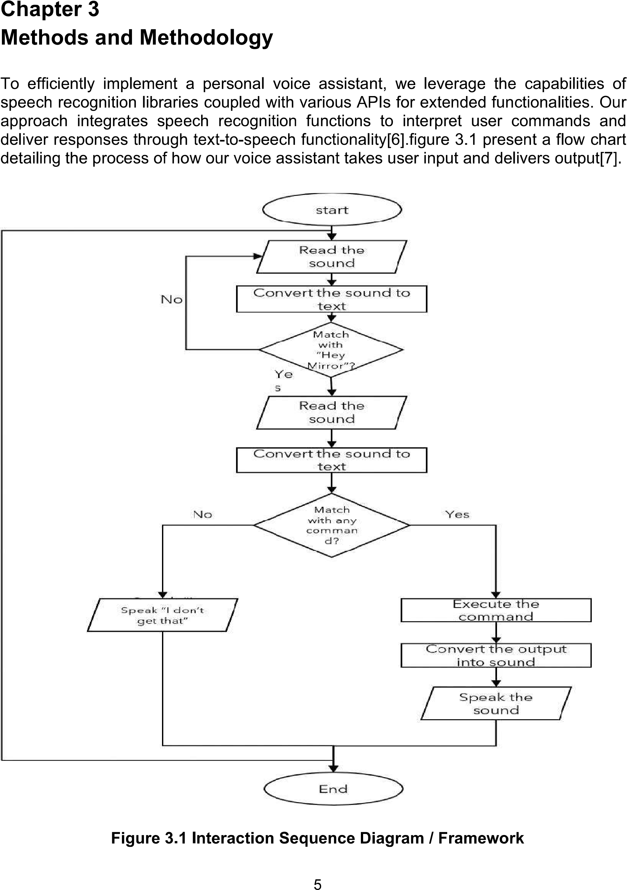
METHODOLOGY …
Figure 2 :- Interaction Sequence Diagram

Slide 11
METHODOLOGY
Speech Recognition Module:
Utilize the Recognizer class to convert audio files into text.
Set energy threshold function to distinguish between silence and speech.
Adjust for ambient noise dynamically using recognizer adjust_for_ambient_noise.
Speech to Text & Text to Speech Conversion:
Employ Pyttsx3 library for text-to-speech conversion, allowing adjustments in Voice, Rate, and Volume.
Utilize Python's Speech Recognition API for converting audio to text.
Include api’s and espeak TTS Engines for processing.
Process & Execute Required Commands:
Convert user commands into text via speech recognition module and analyze.
Execute commands based on user input stored in a text variable within a if-else statement.

Slide 12
METHODOLOGY …
Types of Operations :
Information : Fetch information from Wikipedia based on user input.
Play Video : Open YouTube, search for and play requested videos.
Fact : Provide logical facts upon user request.
Self Introduction : It will give proper information about itself like who made it ,its name and the purpose its making.
Calculation : Able to make calculations accurately by using voice commands and provide answers via speakers.

Slide 13
Implementation
Libraries Required :
Pyttsx3: Converts text to speech, supporting multiple voices (female/male) on various platforms(pip install pyttsx3).
Speech_recognition: Enables speech recognition in Python, allowing computers to understand human language(pip install SpeechRecognition).
Randfacts: Generates random facts, useful for providing interesting information.
Wikipedia: Provides easy access to and parsing of data from Wikipedia.
Selenium WebDriver: Automates web browser interaction, supporting multiple browsers and drivers(pip install selenium).

Slide 14
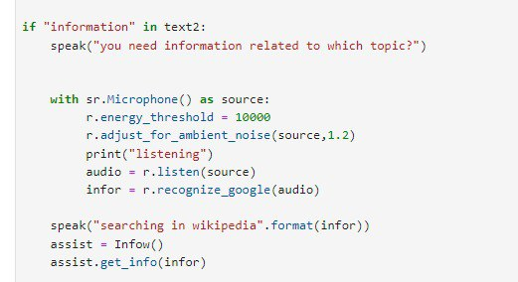
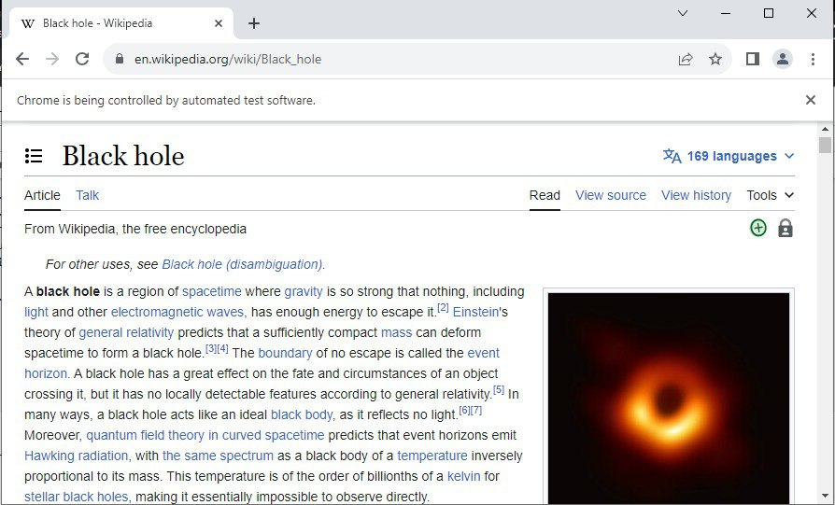

Results
1. INFORMATION RESULT
OUTPUT

Slide 15
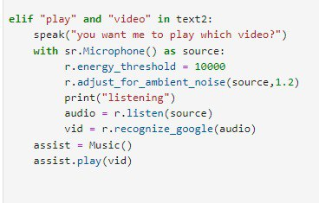
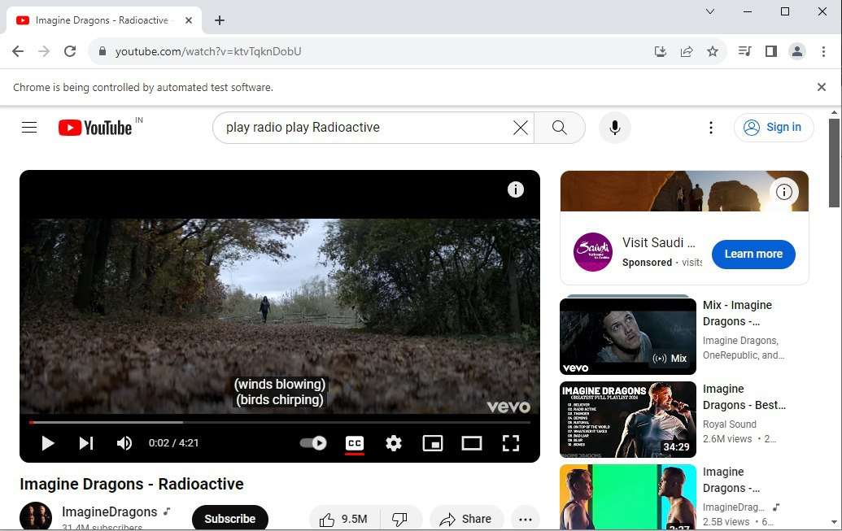
Results
2. VIDEO RESULT
OUTPUT

Slide 16
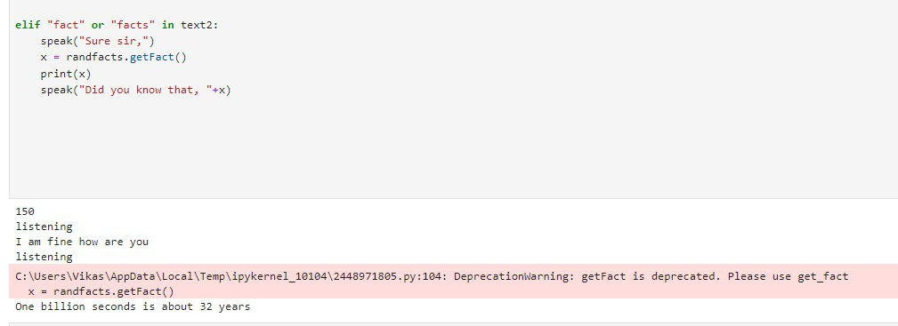
Results
3. RANDOM FACTS

Slide 17
CONCLUSION
Project Deliverables: We have successfully created an AI voice assistant that can retrieve information, give facts, and recommend amusement.
Prospects for Future Development: In order to serve a wider user base, there are plans to improve Natural Language Understanding (NLU) capabilities and add more language support.
Sustained Innovation: Our AI voice assistant will develop further via sustained innovation to provide a more user-friendly and captivating interface, ultimately revolutionizing human-computer interaction in a variety of contexts.

Slide 18
FUTURE SCOPE
Personalization:
Tailor responses based on individual preferences.
Dynamic adjustments using machine learning algorithms.
Multimodal Interaction:
Combine voice input with gestures, facial expressions, and gaze tracking.
Enhance user experience and accessibility.
Domain-Specific Applications:
Deploy in specialized fields (e.g., healthcare).
Assist professionals with tasks while ensuring privacy compliance.
Integration with IOT and Smart Devices:
Orchestrate interactions among interconnected devices.
Control and coordinate smart home, automotive, and industrial environments.

Slide 19
REFERENCES
Deng, L., & Yu, D. (2014). Deep learning: methods and applications. Foundations and Trends® in Signal Processing, 7(3–4), 197–387.
Schuster, M., & Paliwal, K. K. (1997). Bidirectional recurrent neural networks. IEEE Transactions on Signal Processing, 45(11), 2673–2681.
Young, T., Hazarika, D., Poria, S., & Cambria, E. (2019). Recent trends in deep learning based natural language processing. IEEE Computational Intelligence Magazine, 14(3), 55–75.
Vaswani, A., Shazeer, N., Parmar, N., Uszkoreit, J., Jones, L., Gomez, A. N., Kaiser, Ł., & Polosukhin, I. (2017). Attention is all you need. Advances in Neural Information Processing Systems, 30, 5998–6008.
Devlin, J., Chang, M. W., Lee, K., & Toutanova, K. (2018). BERT: Pre-training of deep bidirectional transformers for language understanding. arXiv preprint arXiv:1810.04805.
Mozilla. (n.d.). DeepSpeech: A TensorFlow implementation of Baidu's DeepSpeech architecture. Retrieved from https://github.com/mozilla/DeepSpeech

Slide 20
Thank You

